Slide 1
Wearable Computing for Healthcare Applications
Kai-Chun Liu
April 8, 2020
Notes:
1

Slide 2
Introduction

Slide 3
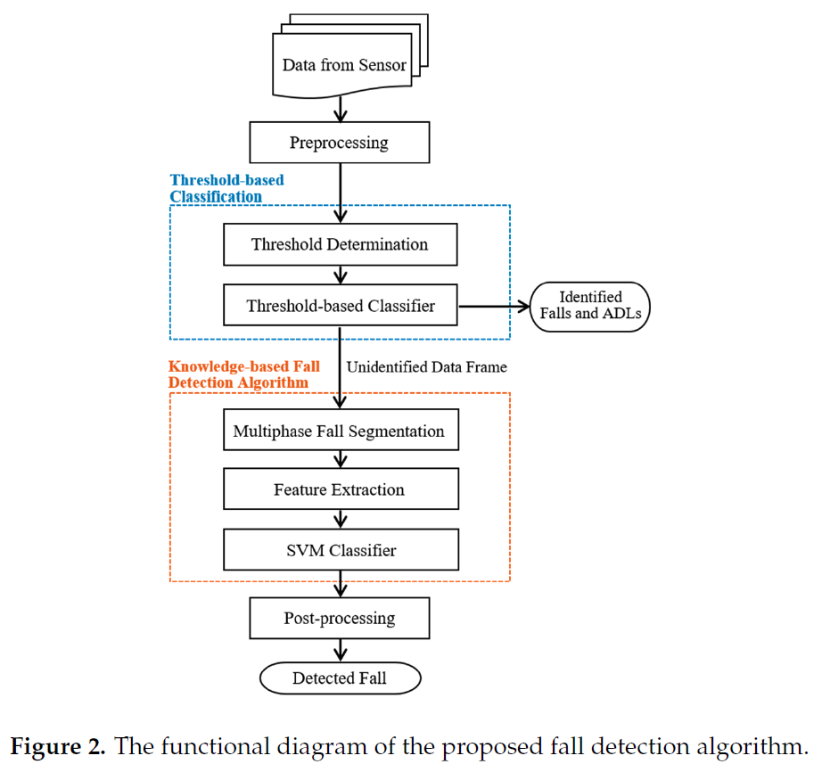
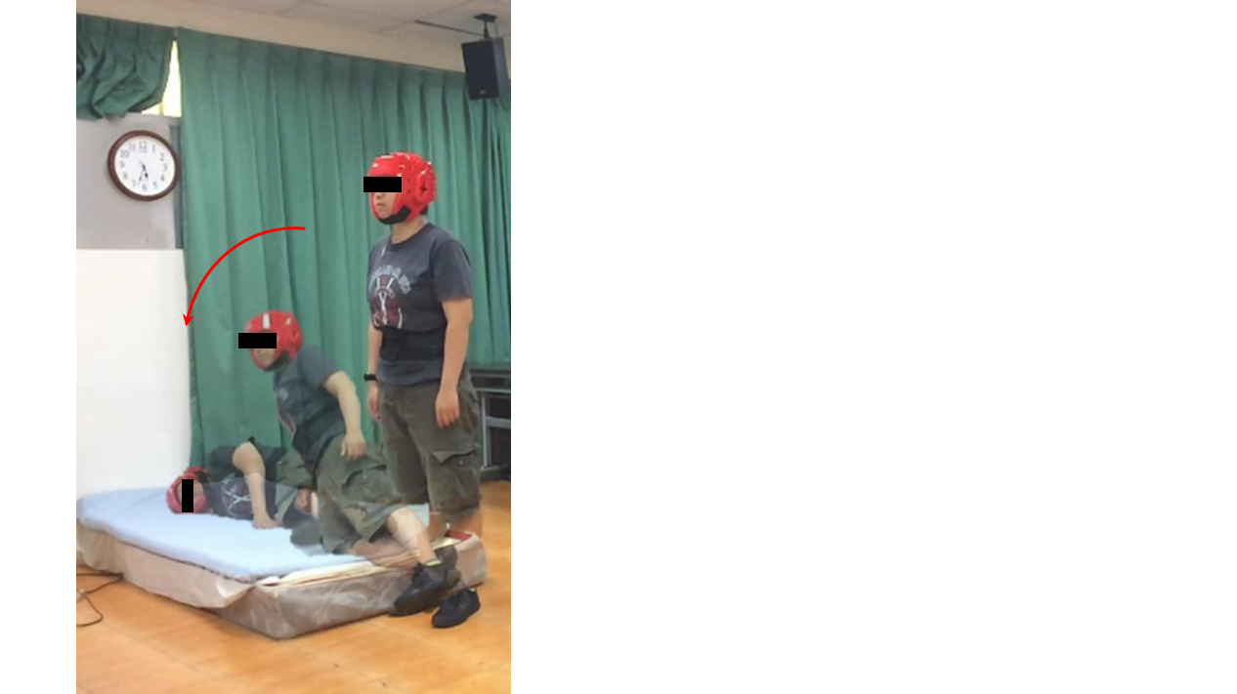
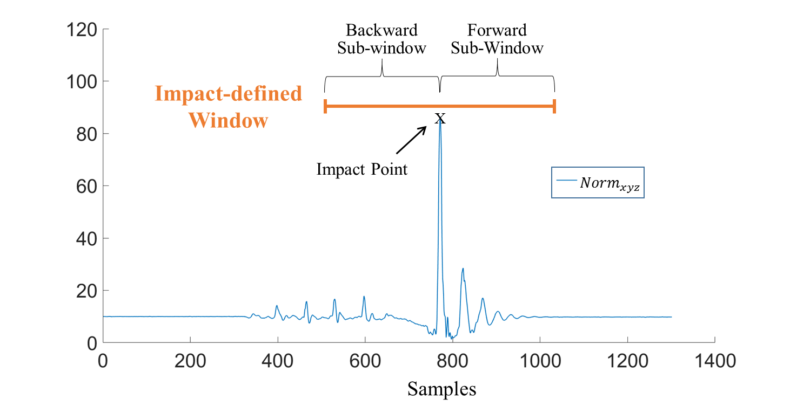

Fall Detection
The proposed fall detection algorithm (Hsieh et al., 2019)

Slide 4
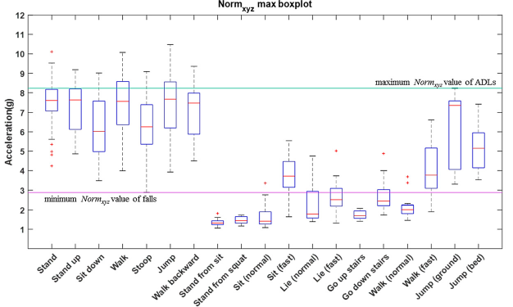
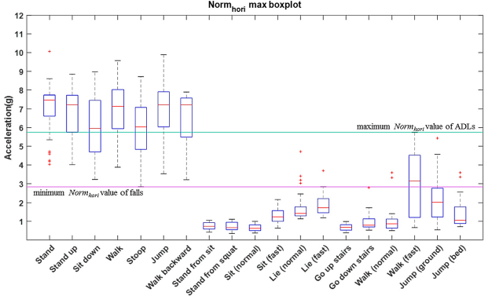
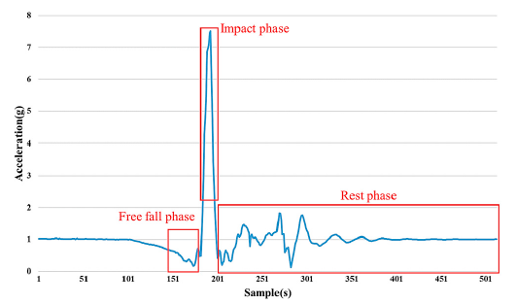
Fall Detection
The proposed fall detection algorithm
Detection performance
99.3% accuracy

Slide 5
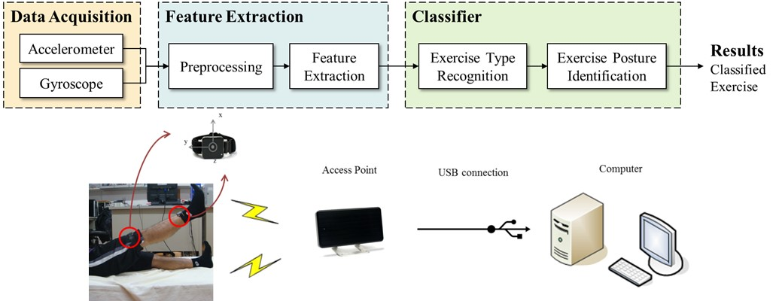
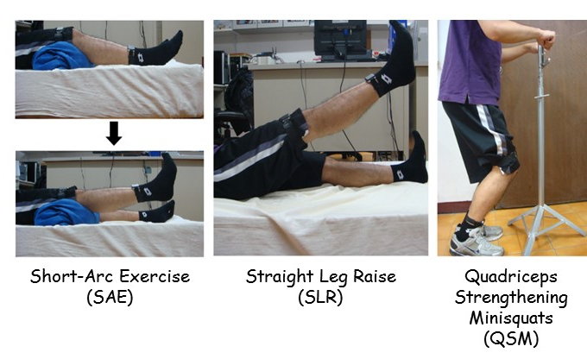
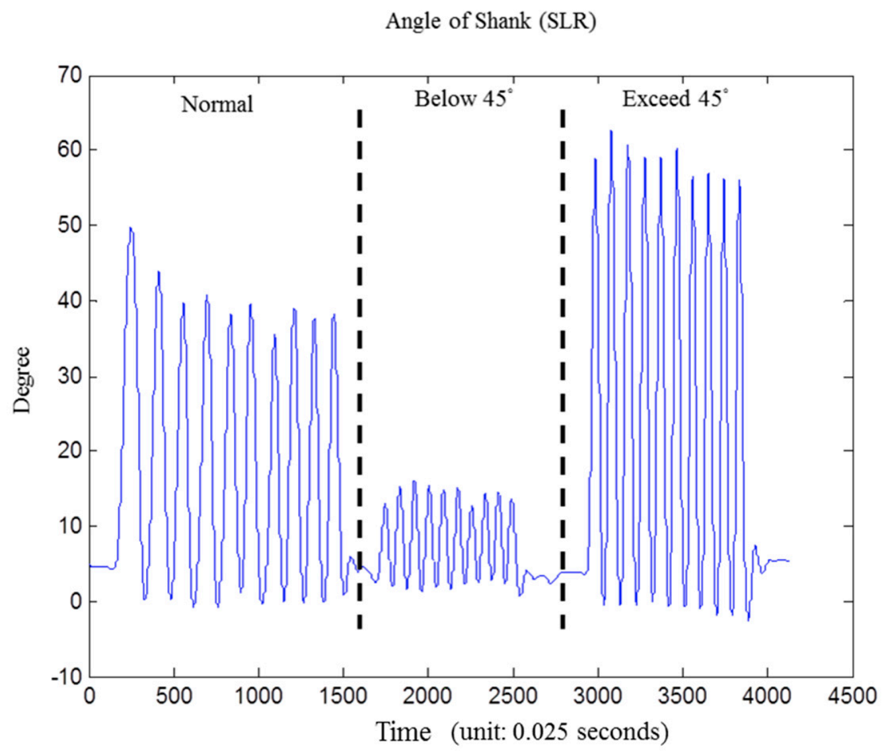
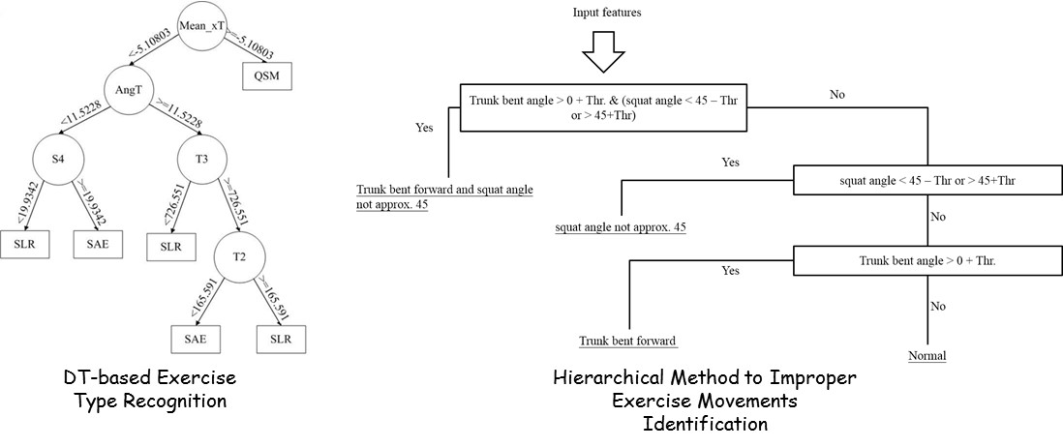
Rehabilitation Exercise Assessment for Knee Osteoarthritis
System Architecture (Chen et al., 2015)
Data Collection
Exercise Type Classifier

Slide 6
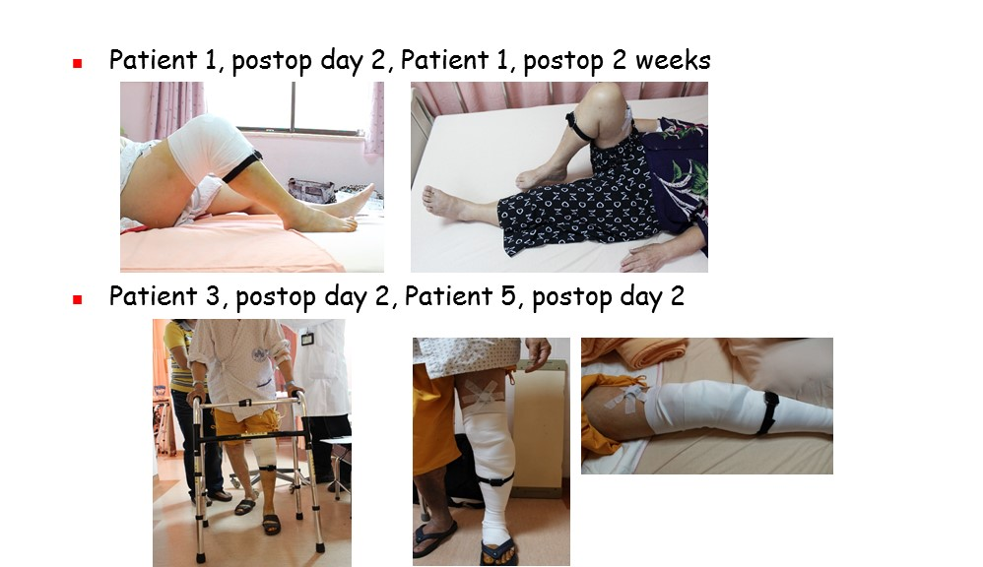
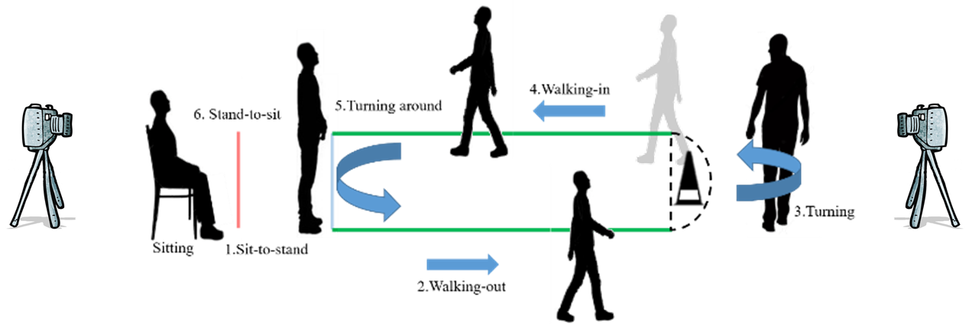
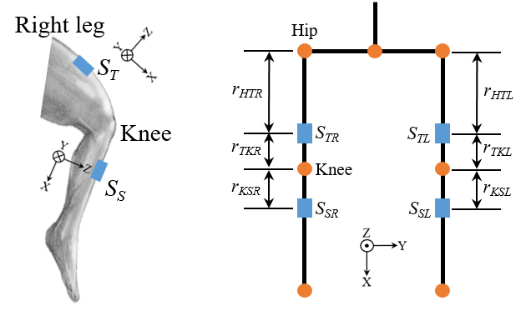
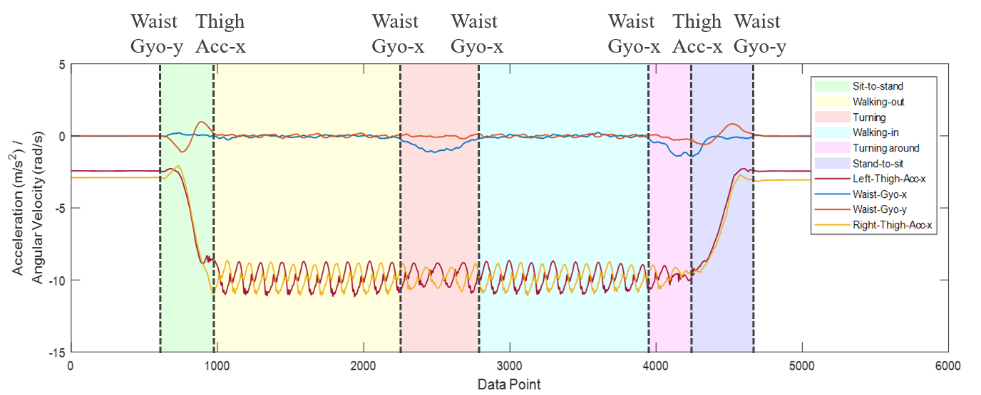
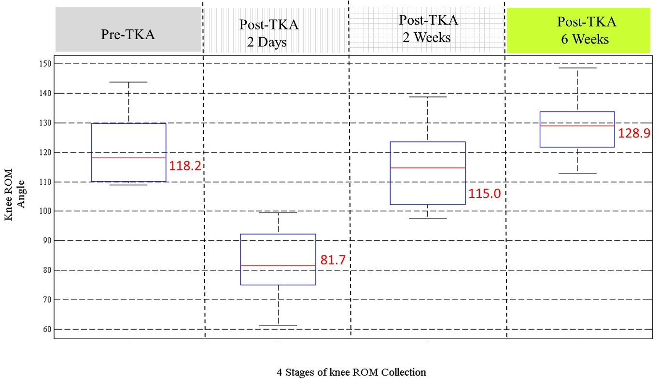
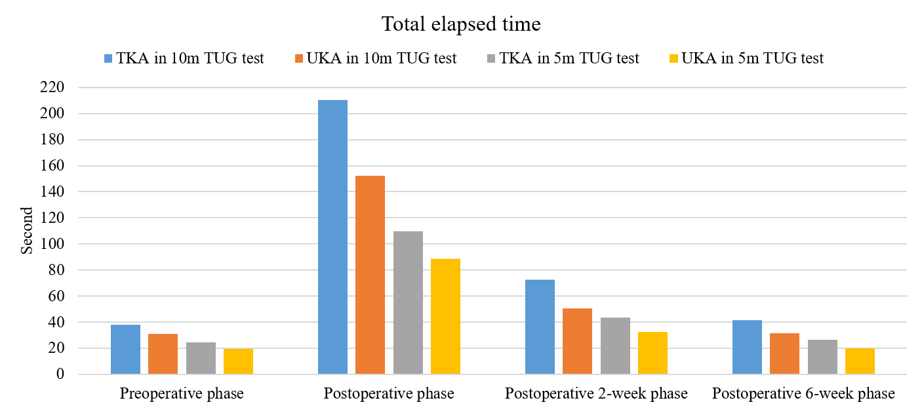
Outcome Measurement for Perioperative Total Knee Arthroplasty
Range of the Knee (Chiang et al., 2017)
Timed-Up-and-Go Test (Hsieh et al., 2019)

Slide 7
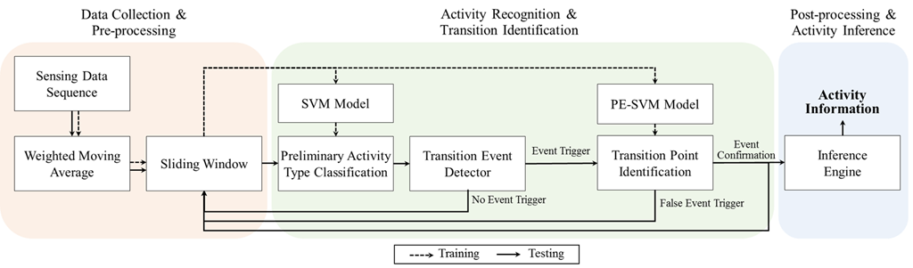
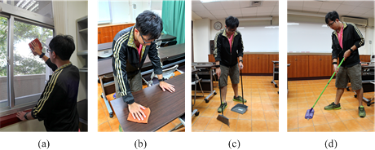
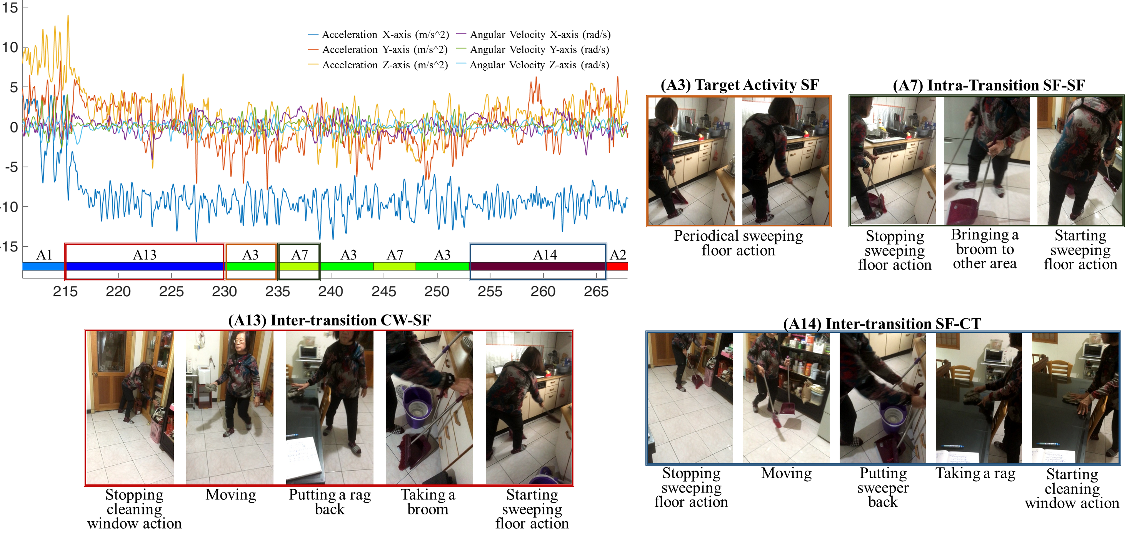
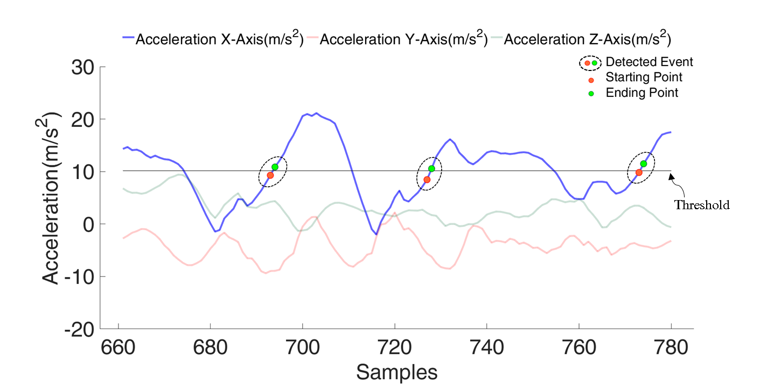
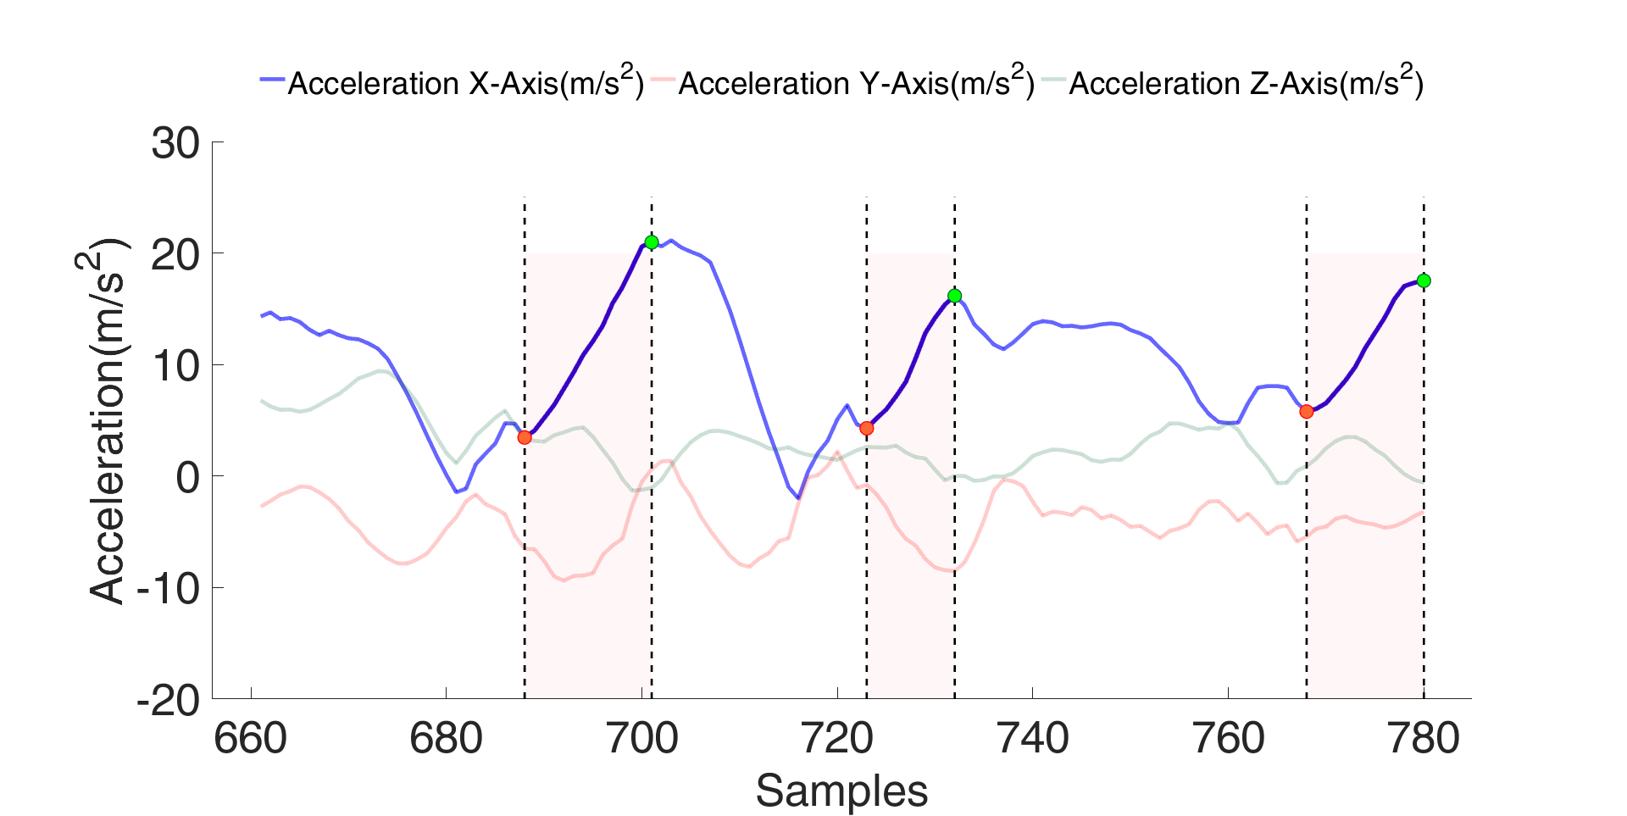
Long-term Daily Activity Monitoring
Fine-grained Activity Recognition
Transitional Activity Recognition (Liu et al., 2019)
Gesture Segmentation (Liu et al., 2018)

Slide 8
Thank You!
Kai-Chun Liu Ph. D.
E-mail: t22302856@citi.sinica.edu.tw
Bio-Audio Signal Processing (Bio-ASP) Lab,
Research Center for Information Technology Innovation (CITI),
Academia Sinica
(Lab Director: Dr. Tsao Yu)
Contact Inform.
Lab Inform.

